Slide 1


PREDICTING CREDIT CARD APPROVAL USING MACHINE LEARNING
Internship Project
Presented By : Vagdevi

Slide 2
OVERVIEW
Problem Statement: Predict the approval or rejection of credit card applications.
Objective: Build a predictive model to assist in the decision-making process.
1

Slide 3
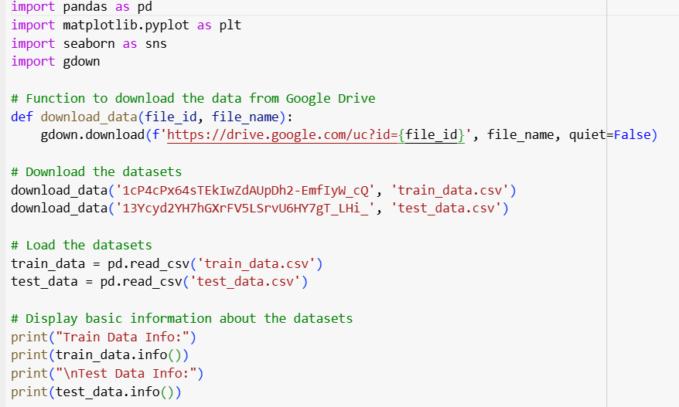
EXPLORATORY DATA ANALYSIS (EDA)
Conduct univariate and bivariate analysis.
Data visualization and summary statistics.
Explanation:
Loading and displaying basic information about the training and testing datasets.
2

Slide 4

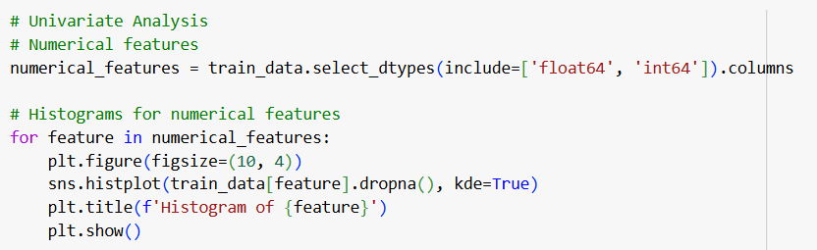
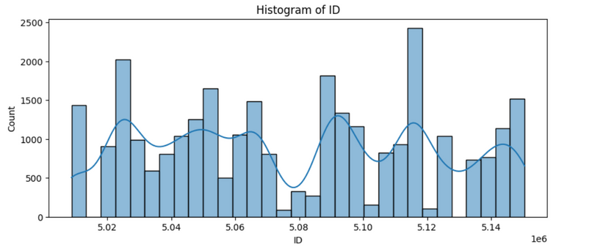
Explanation:
Summary statistics for understanding the distribution of data.
Explanation:
Histograms for numerical features to visualize their distributions.
3

Slide 5
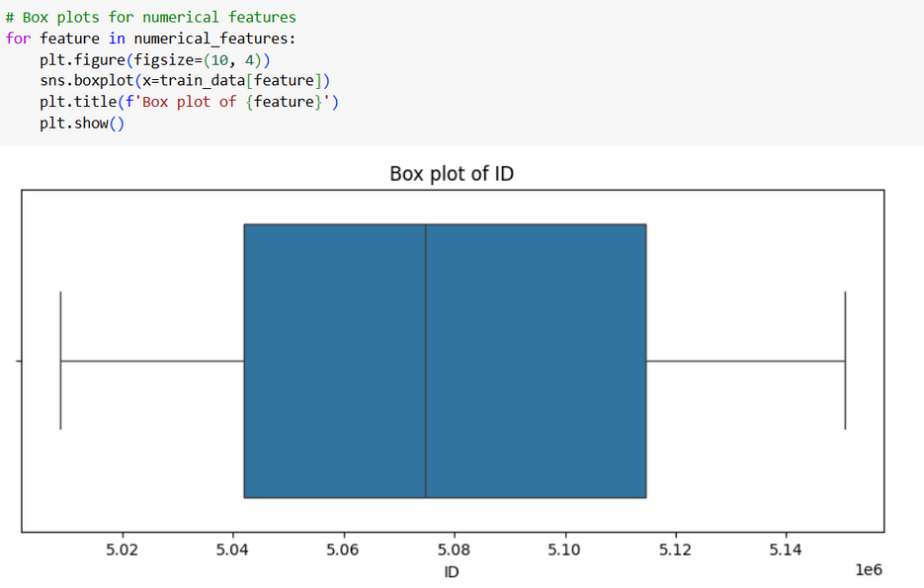
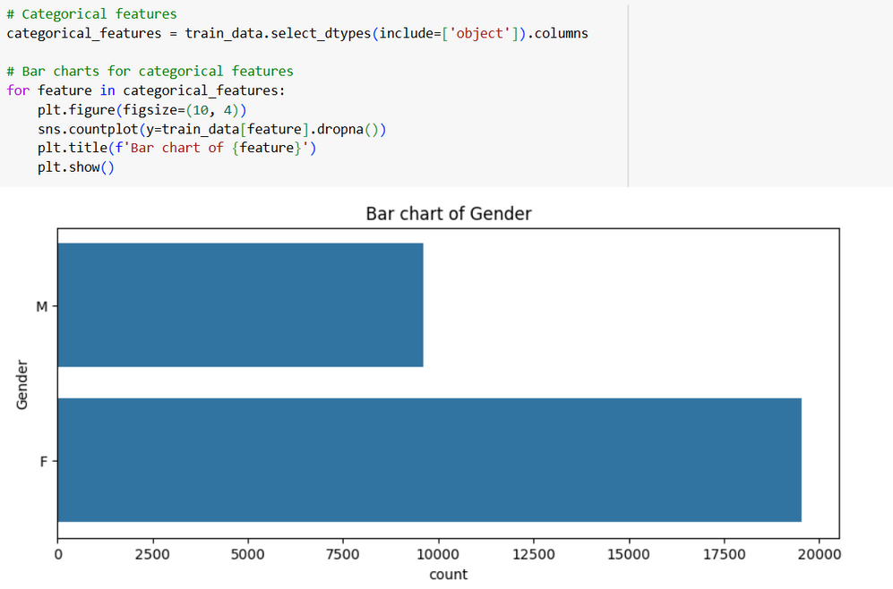
4

Slide 6
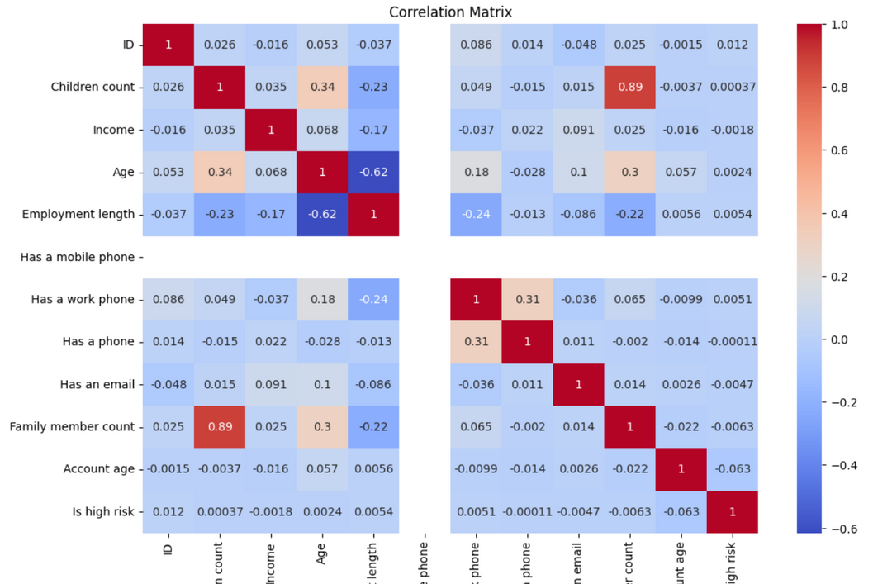
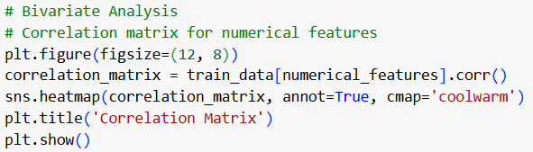
5

Slide 7
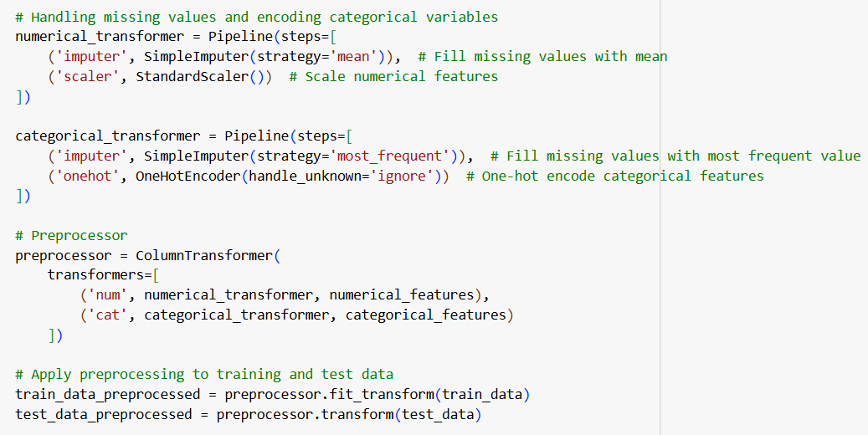
DATA PREPROCESSING
Key Steps:
Handling missing values.
Encoding categorical variables.
Scaling or normalizing features.
6

Slide 8
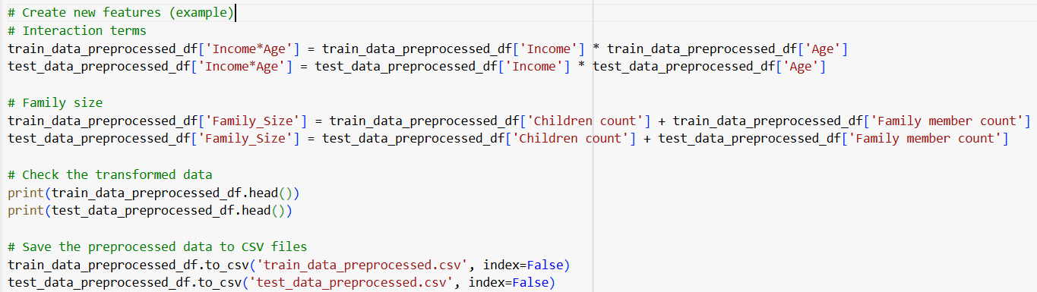
FEATURE ENGINEERING
Key Steps:
Create new features or transform existing ones.
Aggregating information and creating interaction terms.
7

Slide 9
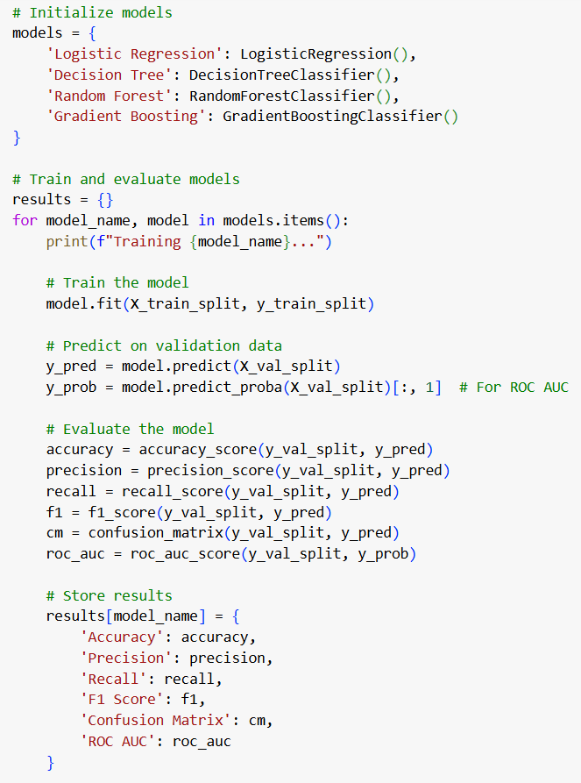
MODEL DEVELOPMENT AND MODEL EVALUATION
Key Steps:
Train various machine learning models.
Experiment with different algorithms.
Assess model performance using metrics like accuracy, precision, recall, F1-score, confusion matrix, and ROC AUC.
8

Slide 10
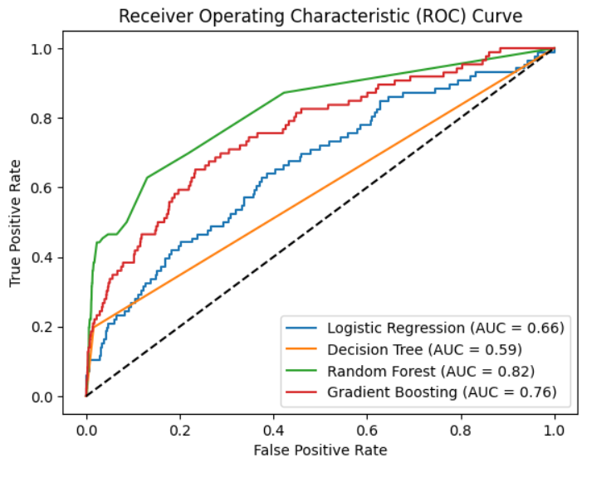
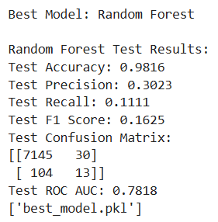
Based on ROC curve
9

Slide 11
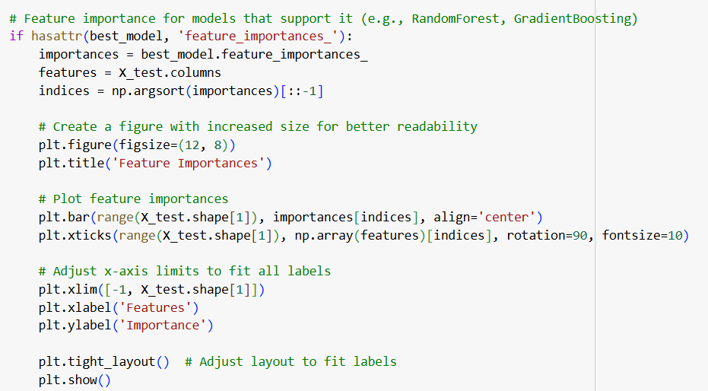
FEATURE IMPORTANCE
10

Slide 12
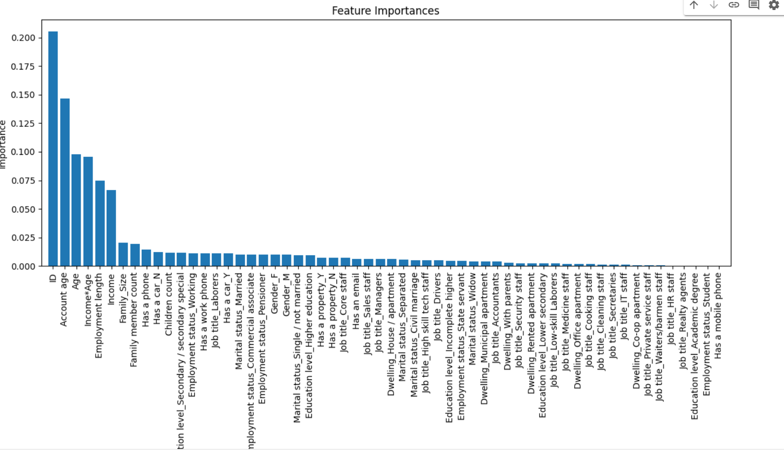
﻿RESULT
11

Slide 13

THANK YOU

